Slide 1
Hypothesis Testing
Osama Bin Ajaz
Lecturer, S & H Dept.,
FAST-NU, Main Campus, Karachi
osama.ajaz@nu.edu.pk

Slide 2
Introduction
Researchers are interested in answering many types of questions. For example:
Scientist might want to know whether the earth is warming up.
A physician might want to know whether a new medication will lower a person’s blood pressure.
An educator might wish to see whether a new teaching technique is better than a traditional one.
A retail merchant might want to know whether the public prefers a certain color in a new line of fashion.
Automobile manufacturers are interested in determining whether seat belts will reduce the severity of injuries caused by accidents.
These types of questions can be addressed through statistical hypothesis testing, which is a decision-making process for evaluating claims about a population.

Slide 3
Three Methods to test statistical Hypothesis
1. The traditional method 2. The P-value method 3. The confidence interval method

Slide 4

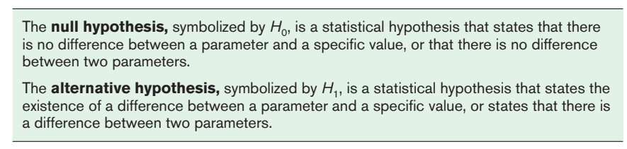
Steps in Hypothesis Testing—Traditional Method
There are two types of statistical hypotheses for each situation: the null hypothesis and the alternative hypothesis.

Slide 5

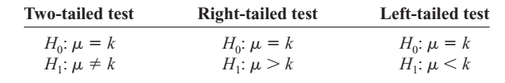
Hypothesis Testing (Contd.)
To state hypotheses correctly, researcher must translate the conjecture or claim from words into mathematical symbols. The basic symbols used are as follows:
The null and alternative hypotheses are stated together, and the null hypothesis contains the equals sign, as shown (where k represents a specified number).

Slide 6
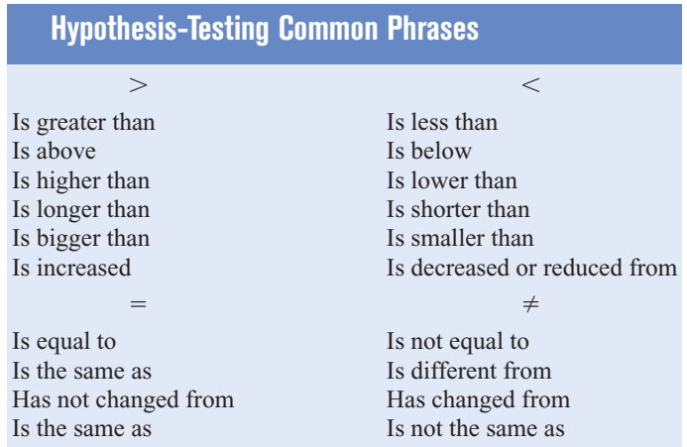

Slide 7
State the null and alternative hypotheses for each conjecture
An engineer hypothesizes that the mean number of defects can be decreased in a manufacturing process of compact disks by using robots instead of humans for certain tasks. The mean number of defective disks per 1000 is 18.
A psychologist feels that playing soft music during a test will change the results of the test. The psychologist is not sure whether the grades will be higher or lower. In the past, the mean of the scores was 73.
A real estate agent claims that 60% of all private residences being built today are 3bedroom homes. To test the claim, a large sample of new residences are inspected; the proportion of these homes with 3 bedrooms is recorded and used as out test statistic state the null & alternative hypotheses.

Slide 8
